Slide 1
Design and Implementation of End to End Secured Campus Area Network
By
Harsh Panchal – 1813033
Kaushal Patil – 1813038
Shubh Dedhia –1813040
Rohit Shah – 1813042
Project Guide
Dr. Kiran Ajetrao

Slide 2
Table of Contents
Introduction
Motivation
Literature Survey
Problem statement
Objectives
Flowchart
Network Topology
Methodology
Demonstration
Results
Conclusion
Future work
References

Slide 3
Introduction
Campus Area Network (CAN) is a group of interconnected Local Area Networks (LAN) within a limited geographical area like school campus, university campus, military bases, or organizational campuses and corporate buildings.
Example of CAN : Let’s think about a university where university networks interconnect academic building, admission building, library, account section, examination section, placement section etc of an institution when connected with each other combine to form Campus Area Network (CAN).

Slide 4
Motivation:
The core motivation behind developing this project is to maximize security on campus in the era of ever increasing data and various threats and attacks associated to it.
As college data is very crucial when it comes to any level of the campus network so to prevent any privacy breach of any entity a secured network is very much necessary.
With the Pandemic, Things going virtual and studying/working from home has become the new normal, the security aspect must go hand in hand to ensure smooth functioning of life on virtual campus.
To prevent malicious attacks which has potential to hamper the life of a student or faculty

Slide 5
Literature Survey
Publisher | Year | Author | Title | Summary | Gaps Identified | Problem Solved
IJRTE | 2019 | Mugdha Sharma, Chirag Pupreja, Akash Arora | Design and Implementation of University Network | This paper presents the design of campus area network using Bus topology | There are various topologies for designing a network which were quite expensive. | In the current network we have used bus topology as it is a cost effective

Slide 6
Literature Survey
Publisher | Year | Author | Title | Summary | Gaps Identified | Problems Solved
IJETTCS | 2014 | S. Sudharsan, M. Naga Srinivas, G. Sai Shabareesh, P.Kiran Rao | Campus Network Security And Management | This paper presents the design of campus area network using star topology | Inter department Communication was not possible. | In the current network we have used VLANs for inter department communication using InterVLAN Routinng

Slide 7
Literature Survey
Publisher | Year | Author | Title | Summary | Gaps Identified | Problems Solved
IJPAM | 2017 | G.Michael | Design And Implementation Of A Secure Campus Network | This paper represented the current network security of the campus network, analyzes security threats to campus network and represented the ways to solve it. | There were various network attacks due to which campus area was not secured. | By making hierarchical network design, the network could resist most of network attacks and hence security was improved

Slide 8
Literature Survey
Publisher | Year | Author | Title | Summary | Gaps Identified | Problems Solved
Researchgate | 2011 | Lalita Kumari, Swapan Debbarma, Radhey Shyam | Security Problems in Campus Network and Its Solutions | This paper represents the current security status of the campus network and to analyze security threats to campus network | As campus area network is vast and due to its complex network there are many network security issues which needs to be resolved | Using Firewall technology, VLAN, encryption technology, VPN, multiple operating system at server side enchances network security

Slide 9
Problem Statement
Campus network faces the security challenges which are influenced by network infrastructure.
Secured network will guard valuable data and information of an organization from security attacks associated with network.
To maintain data privacy and campus integrity the campus network needs to have secure network design to protect from different types of threats and attacks.

Slide 10
Objectives
Design of Secured Robust Campus Area Network.
Creation of VLANs, OSPFs, ACLs and implementing firewall for internal and external security of network.
For security of the network, we will identify the threats which can happen in a campus area network and analyze them.
Validation of Small network using Hardware Setup.

Slide 11
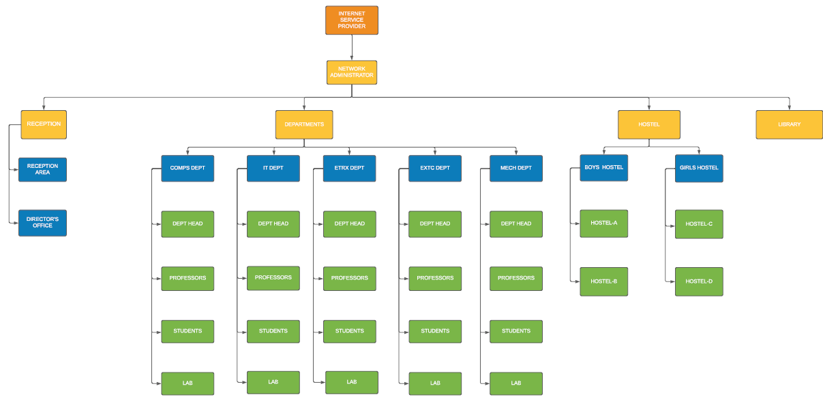
Flowchart

Slide 12
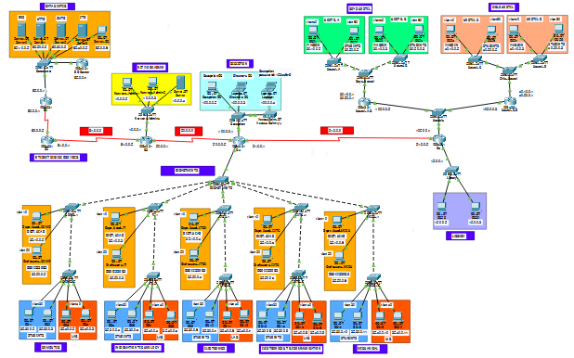
Network Topology

Slide 13
Methodology
Virtual LANs (VLANs)
Created vlans for Dept. Head, Professors, Students and lab for Each of the 5 Departments.
Created vlans for Boys Hostel (Hostel-A, Hostel-B) and Girls Hostel (Hostel-C, Hostel-D).
In Boys Hostel, anyone can communicate within Hostel-A,B
In Girls Hostel, anyone can communicate within Hostel-C,D

Slide 14
Methodology
2) InterVLAN Routing (Router on stick method)
Inter VLAN routing is a process in which we make different virtual LANs communicate with each other irrespective of where the VLANs are present (on same switch or different switch).
Inter Vlan Routing can be achieved through a layer-3 device i.e. Router or layer-3 Switch. When the Inter VLAN Routing is done through Router it is known as Router on a stick.
SSH Configuration on Network Admin’s Router and Switch

Slide 15
Demonstration

Slide 16
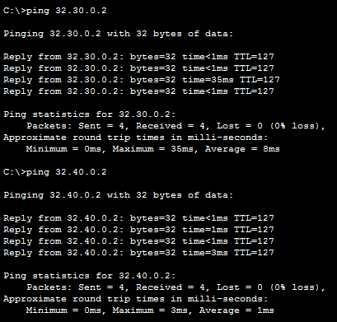
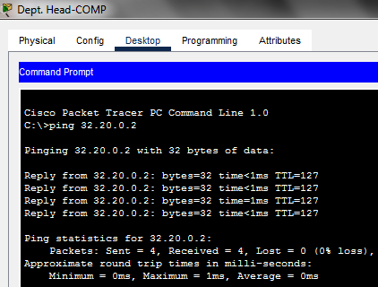
Results
From Computer Department: Dept. Head can communicate with professors, students, lab of Computer Department and can also communicate with other department’s Dept. head, professors, students and lab

Slide 17
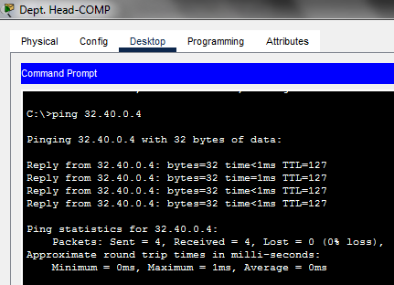
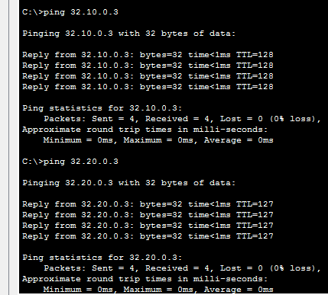
Results

Slide 18
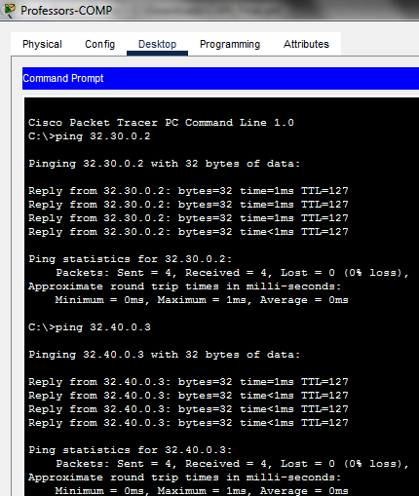
Results

Slide 19
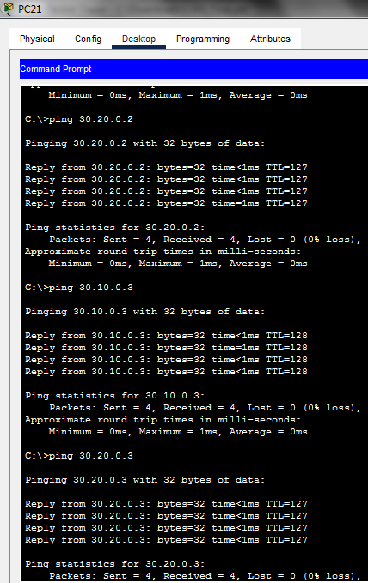
Results
From Hostel-A: Warden from Hostel-A can communicate with students of Hostel-A and also warden, students of Hostel-B

Slide 20
Conclusion
The network is fully featured with ISP, Data Center, Network administration, interconnection of various departments, Hostels and library.
Network architecture and its security are necessary for any organization.
Maintenance of high efficiency of campus network is main problem that need to be resolved.

Slide 21
Future Work
Creating OSPFs, ACLs and implementing ASA firewall
Limiting bandwidth and access to internet to specific users in the network
Conduct a survey at data center to learn about possible attacks and disaster recovery and thereby implementing it on mininet software
Identify and analyze threats and take preventive measures
Validation of Small network using Hardware Setup.

Slide 22
References
Mugdha Sharma, Chirag Pupreja, Akash Arora “Design and Implementation of University Network” July 2019 International Journal of Recent Technology and Engineering (IJRTE)
URL: https://www.ijrte.org/wp-content/uploads/papers/v8i2S6/B11740782S619.pdf
S. Sudharsan, M. Naga Srinivas, G. Sai Shabareesh, P.Kiran Rao “CAMPUS NETWORK SECURITY AND MANAGEMENT” November-December 2014 International Journal of Emerging Trends & Technology in Computer Science (IJETTCS)
URL: https://www.ijettcs.org/Volume3Issue6/IJETTCS-2014-11-21-53.pdf

Slide 23
References
Lalita Kumari Radhey Shyam Swapan Debbarma “Security Problems in Campus Problems and its solutions” January 2011 ResearchGate
URL:https://www.researchgate.net/publication/224771078_Security_Problems_in_Campus_Network_and_Its_Solutions
G.Michael “Design and Implementation of a Secure Campus Network” 2017 International Journal of Pure and Applied Mathematics(IJPAM)
URL: https://acadpubl.eu/jsi/2017-116-8/articles/8/51.pdf

Slide 24
THANK YOU

